Slide 1
Model Interpretability
For Orlando Machine Learning and Data Science Meetup
8/3/2019
Discussion led by Kevin Kho

Slide 2
ABOUT ME
Education
BS Civil Engineering
University of Illinois at Urbana-Champaign
Work
Itron (2017 - Present)
Thinkful (Aug 2017 - Jan 2019)
OMLDS
Co-organizer since one or two months ago
Second Talk
MS Civil Engineering
DataKind (2018)
Volunteer

Slide 3
Motivation
Important for certain industries
“Right to explanation”
Legal/Financial decisions that adversely affect an individual
GDPR - Feb 2019 - Polish credit
Sources:
https://www.kdnuggets.com/2019/05/interpretability-machine-learning-models.html
https://en.wikipedia.org/wiki/Right_to_explanation

Slide 4
Use Cases
Trust of clients/stakeholders
Safety/Detecting Bias
Predicting cases of failure
Bike example
Test sets tend to be clearer
New values of features coming in
Recourse Analysis
Defense Against Adversarial Attacks
Manipulating the system (credit)
Sources:
https://christophm.github.io/interpretable-ml-book/

Slide 5
RESOURCES
Book by Christopher Molnar
https://christophm.github.io/interpretable-ml-book/

Slide 6
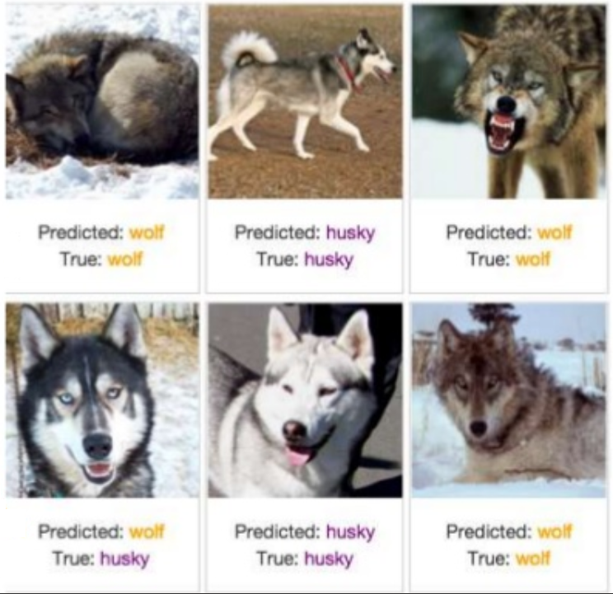
Use Case - Detecting Bias
Sources:
https://christophm.github.io/interpretable-ml-book/
https://www.slideshare.net/0xdata/explaining-blackbox-machine-learning-predictions

Slide 7
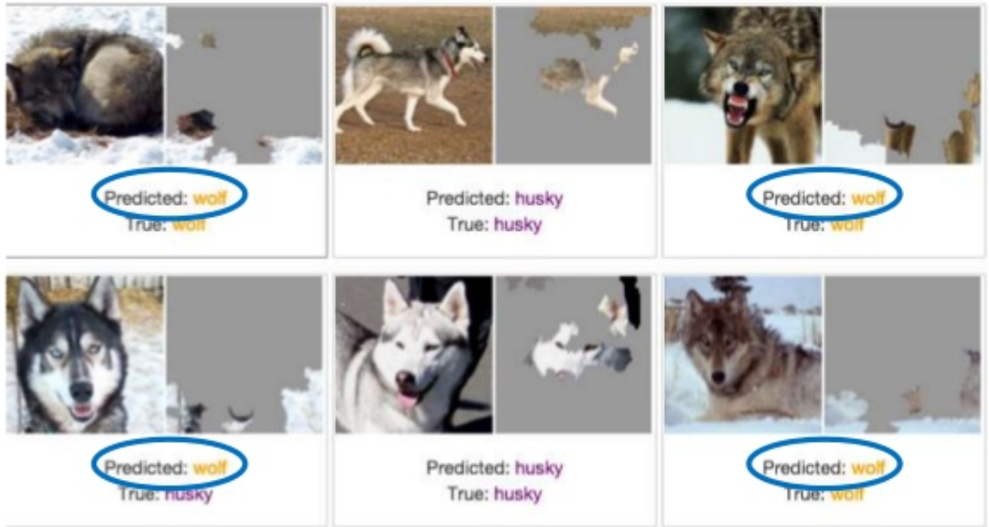

Slide 8
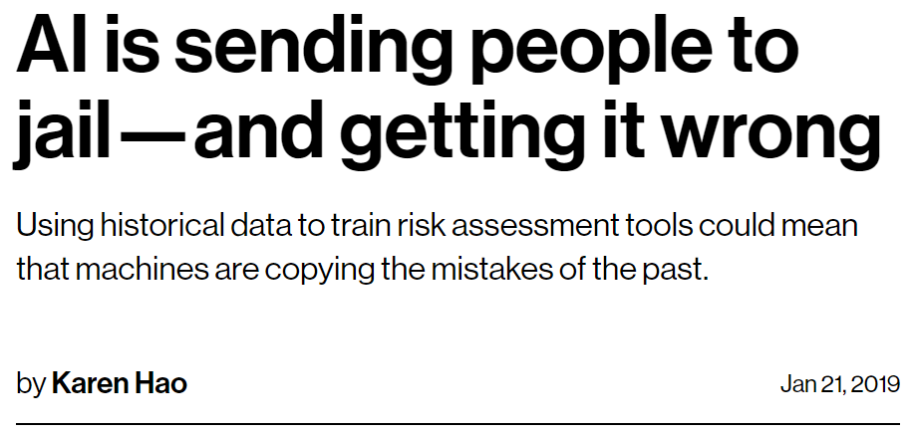
Machine Learning Bias
Sources:
https://www.technologyreview.com/s/612775/algorithms-criminal-justice-ai/

Slide 9
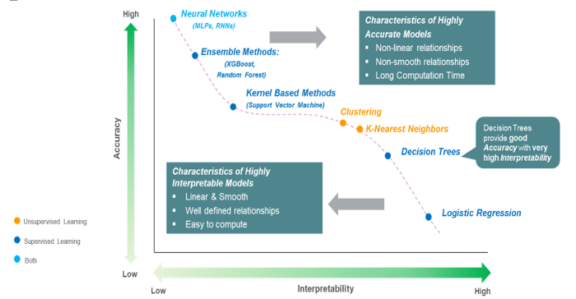
Complexity versus Interpretability
Sources:
https://towardsdatascience.com/the-balance-accuracy-vs-interpretability-1b3861408062

Slide 10
Interpretable Machine Learning Models
Linear Regression
Logistic Regression
Decision Trees
K-nearest neighbors

Slide 11
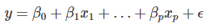
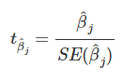
Linear Regression
Highly interpretable

Slide 12
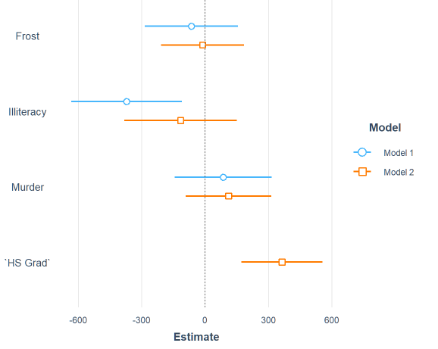
Linear Regression - Coefficient Plots
Source:
https://cran.r-project.org/web/packages/jtools/vignettes/summ.html
state.x77 data

Slide 13
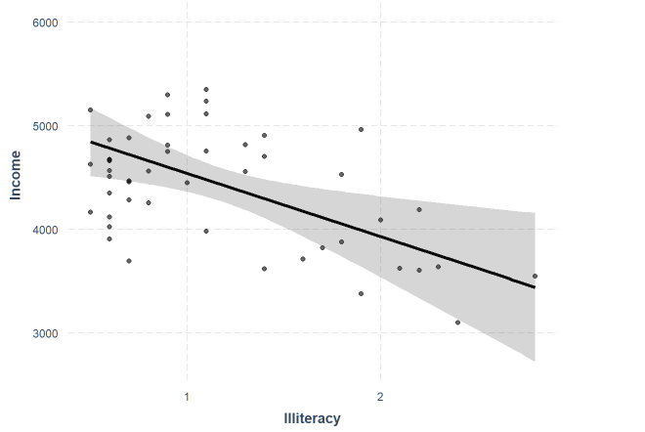
Linear Regression - Effect Plot
Source:
https://stat.ethz.ch/R-manual/R-patched/library/datasets/html/state.html

Slide 14
Linear Regression
Advantages:
Highly interpretable
Disadvantages:
The need to handcraft features
Breaks down whenever there is correlation
Source:
https://christophm.github.io/interpretable-ml-book/limo.html

Slide 15
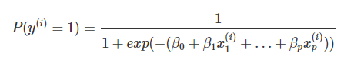
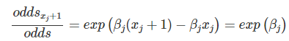
Logistic Regression

Slide 16
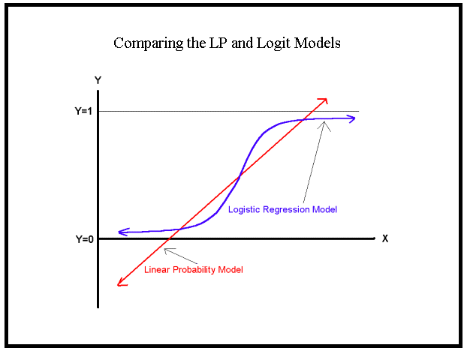
Logistic Regression
https://medium.com/greyatom/logistic-regression-89e496433063

Slide 17
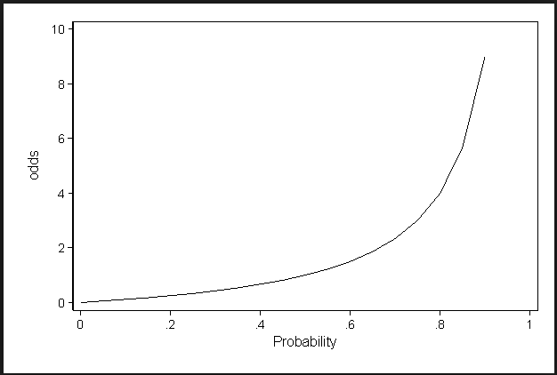
Logistic Regression

Slide 18
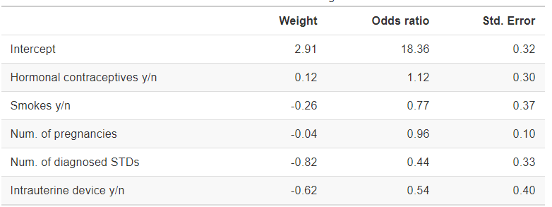
Logistic Regression
https://christophm.github.io/interpretable-ml-book/logistic.html

Slide 19

K-Nearest Neighbors
Check the neighbors and their weights
Interpretable only on a local level
https://www.analyticsvidhya.com/blog/2018/03/introduction-k-neighbours-algorithm-clustering/

Slide 20
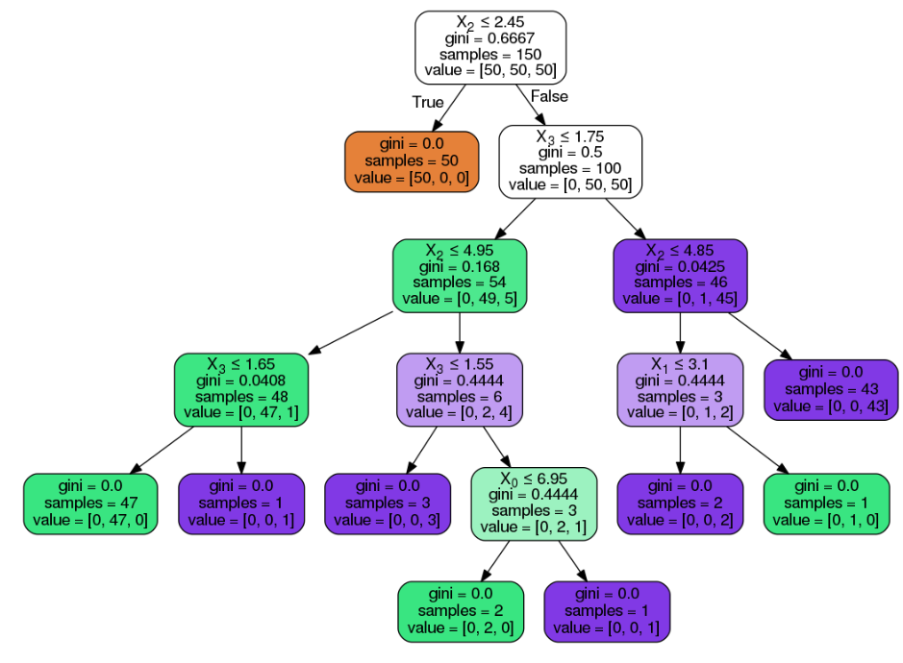
Decision Tree
https://medium.com/@rnbrown/creating-and-visualizing-decision-trees-with-python-f8e8fa394176

Slide 21
Decision Tree
Advantages
Captures interactions
Easy to visualize (for short trees)
Disadvantages
Lack of smoothness
Unstable

Slide 22
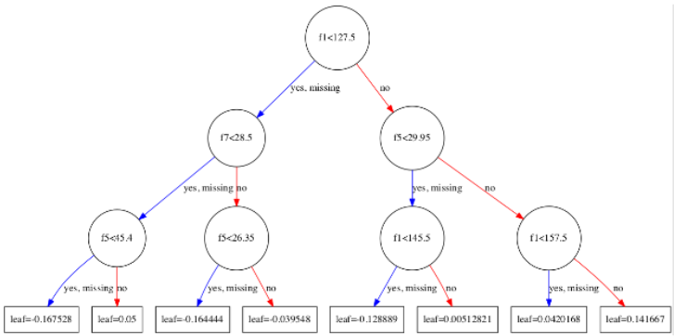
Gradient Boosting (XGBoost)
https://machinelearningmastery.com/visualize-gradient-boosting-decision-trees-xgboost-python/

Slide 23
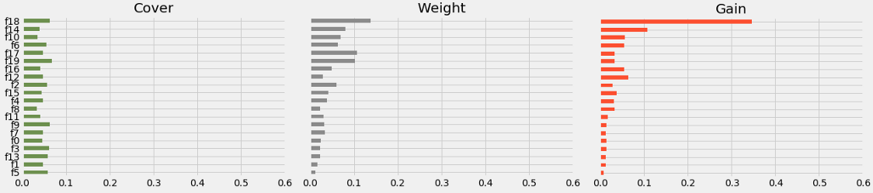
Gradient Boosting (XGBoost)
Source:
https://towardsdatascience.com/be-careful-when-interpreting-your-features-importance-in-xgboost-6e16132588e7

Slide 24
Eli5 (Python only)
API for Sklearn, XGBoost, LightGBM, CatBoost
show_weights()
show_prediction()

Slide 25
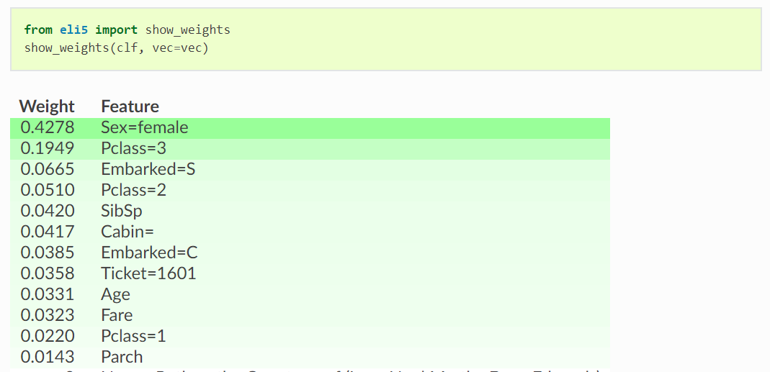
Eli5 - show_weights()
https://eli5.readthedocs.io/en/latest/tutorials/xgboost-titanic.html

Slide 26
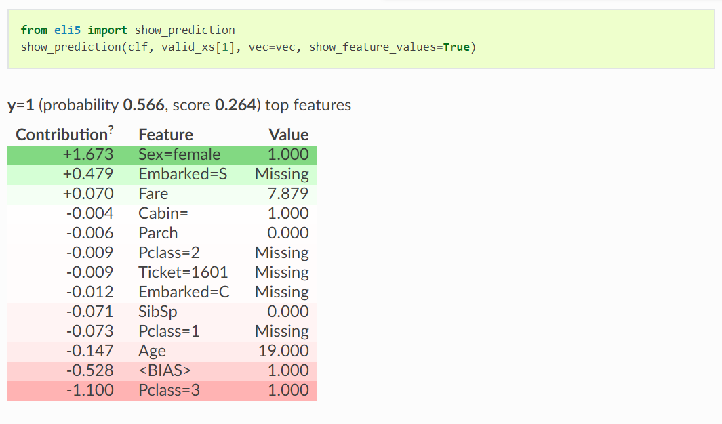
Eli5 - show_prediction()
https://eli5.readthedocs.io/en/latest/tutorials/xgboost-titanic.html

Slide 27
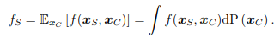
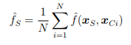
Partial Dependence Plots - Theory
Sources:
https://bgreenwell.github.io/pdp/articles/pdp.html
https://statweb.stanford.edu/~jhf/ftp/trebst.pdf

Slide 28
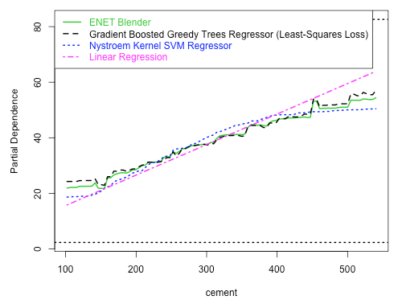
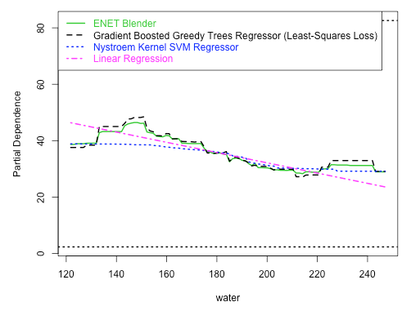
Partial Dependence Plots - Example
Sources:
https://cran.r-project.org/web/packages/datarobot/vignettes/PartialDependence.html

Slide 29
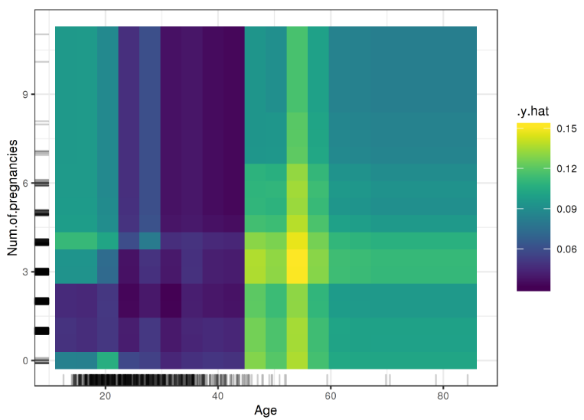
Partial Dependence Plots - 2 Dimensions
Sources:
SAS Software: https://www.youtube.com/watch?v=J3UpVJKluvA

Slide 30
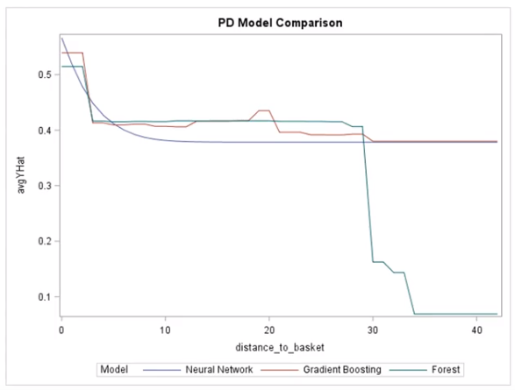
Partial Dependence Plots - Model Comparison
Sources:
SAS Software: https://www.youtube.com/watch?v=J3UpVJKluvA

Slide 31
Partial Dependence Plots - Additional Info
Advantages
Easy to interpret, intuitive
Disadvantages
Maximum of 2 features
Interpolates
Assumes independence
Hides heterogeneous effects
Sources:
https://christophm.github.io/interpretable-ml-book/pdp.html

Slide 32
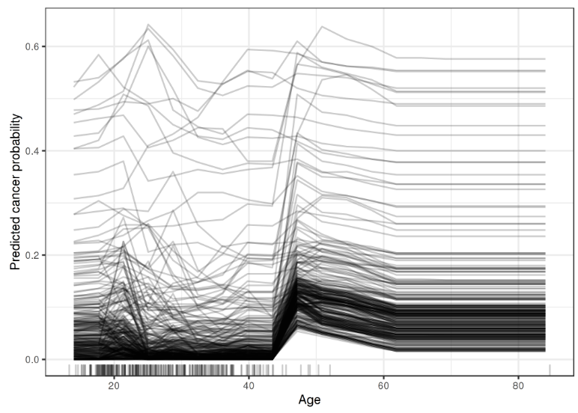
Individual Condition Explanation (ICE)
Sources:
https://christophm.github.io/interpretable-ml-book/ice.html

Slide 33
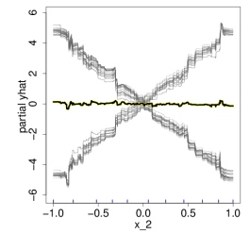
Individual Condition Explanation (ICE)
Sources:
https://christophm.github.io/interpretable-ml-book/ice.html

Slide 34
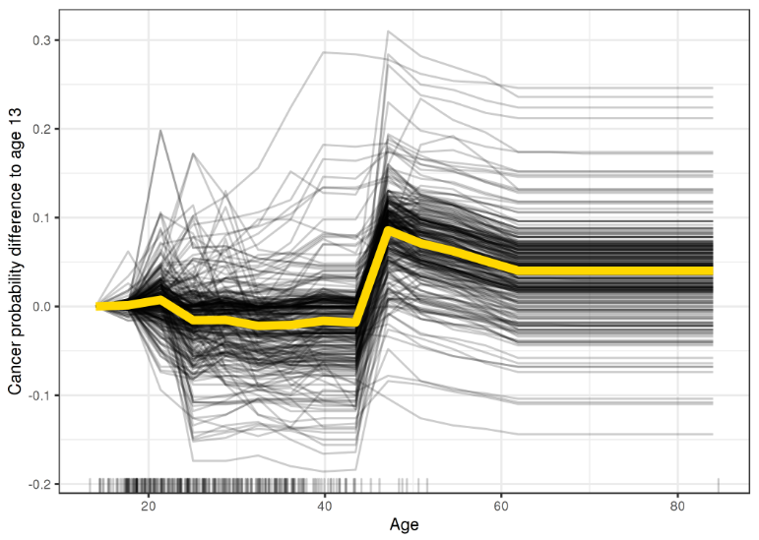
Individual Condition Explanation (ICE)
Sources:
https://christophm.github.io/interpretable-ml-book/ice.html

Slide 35
Individual Condition Explanation (ICE)
Advantages
More granularity to feature
Can uncover heterogenous relationships
Disadvantages
Maximum of 1 feature
Crowded plots
Sources:
https://christophm.github.io/interpretable-ml-book/ice.html

Slide 36
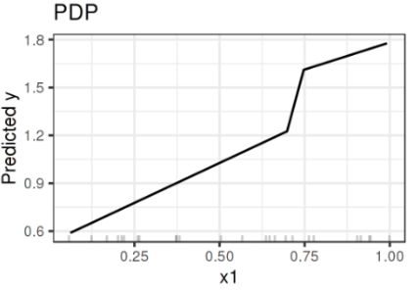
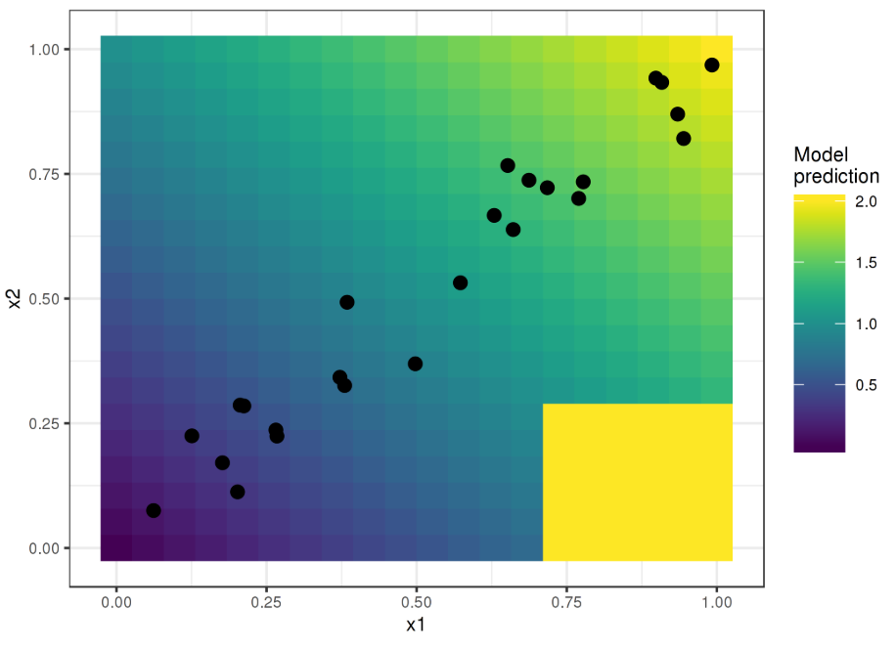
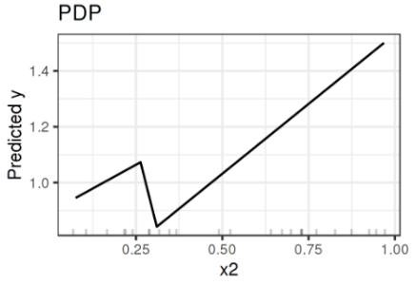
Accumulated Local Effects
Sources:​
https://christophm.github.io/interpretable-ml-book/ale.html

Slide 37
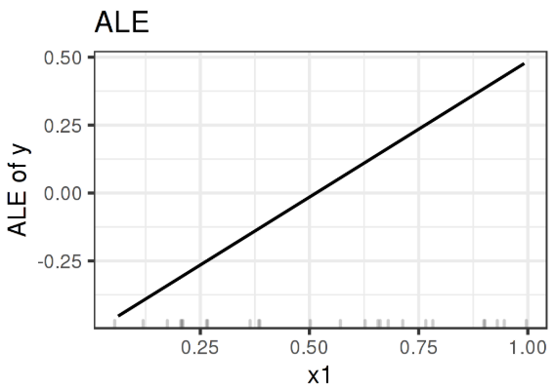
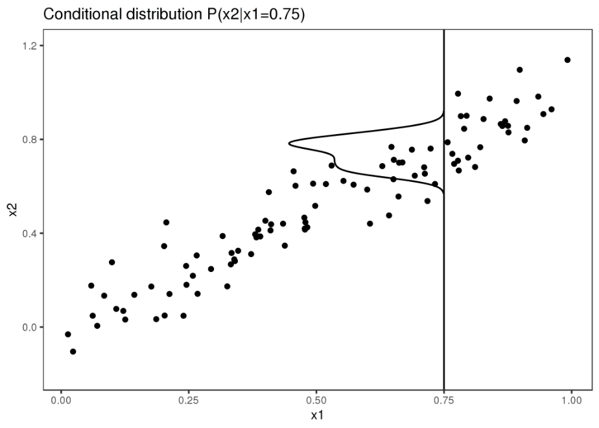
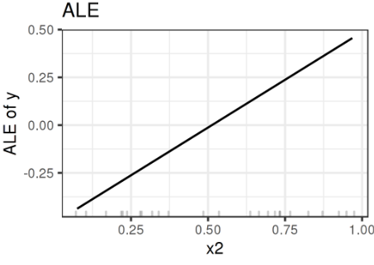
Accumulated Local Effects
Sources:​
https://christophm.github.io/interpretable-ml-book/ale.html

Slide 38
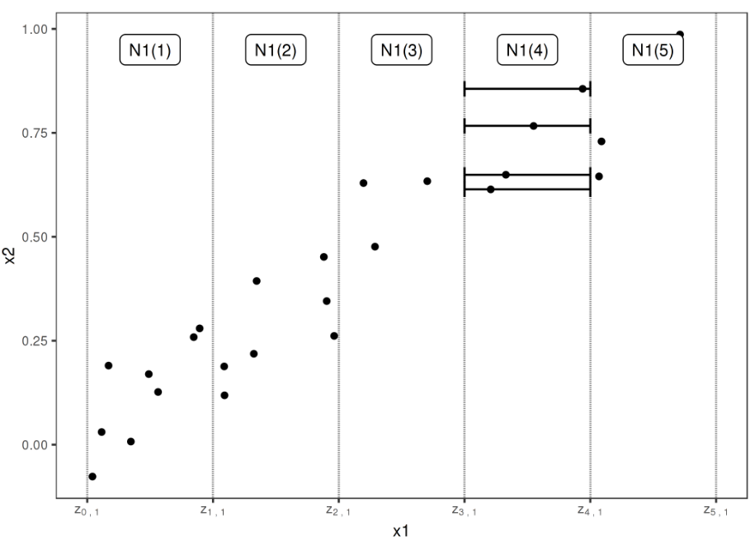
Accumulated Local Effects
Sources:​
https://christophm.github.io/interpretable-ml-book/ale.html

Slide 39
Accumulated Local Effects
Advantages
Unbiased
Faster to compute
Disadvantages
Need a lot of samples per bin
Increased complexity

Slide 40
Global Surrogate
Approximate model with a second model that is more explanable
Compare the R^2 values to see the agreement
Notes on Usage:
Intuitive
Surrogate never sees original Y values
If R^2 is very close, might as well change to the second model

Slide 41
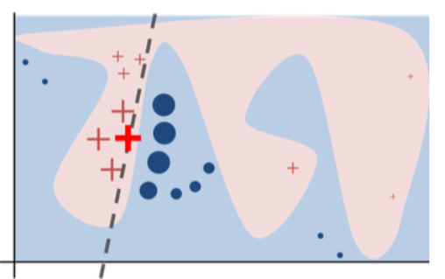
Local Interpretable Model-Agnostic
Explanations
https://arxiv.org/pdf/1602.04938.pdf

Slide 42
Local Interpretable Model-Agnostic
Explanations
For each prediction to explain, permute the observation n times.
Let the complex model predict the outcome of all permuted observations.
Calculate the distance from all permutations to the original observation.
Convert the distance to a similarity score.
Select m features best describing the complex model outcome from the permuted data.
Fit a simple model to the permuted data, explaining the complex model outcome with the m features from the permuted data weighted by its similarity to the original observation.
Extract the feature weights from the simple model and use these as explanations for the complex models local behavior.
https://cran.r-project.org/web/packages/lime/vignettes/Understanding_lime.html

Slide 43
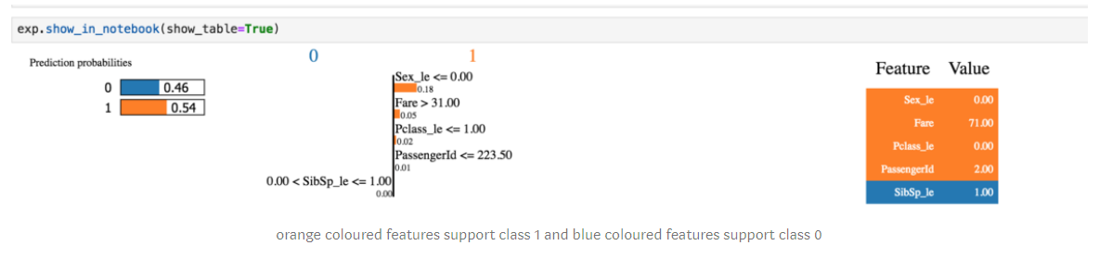
LIME - Tabular Data
Data needs to be LabelEncoded
Check R^2
https://towardsdatascience.com/decrypting-your-machine-learning-model-using-lime-5adc035109b5

Slide 44
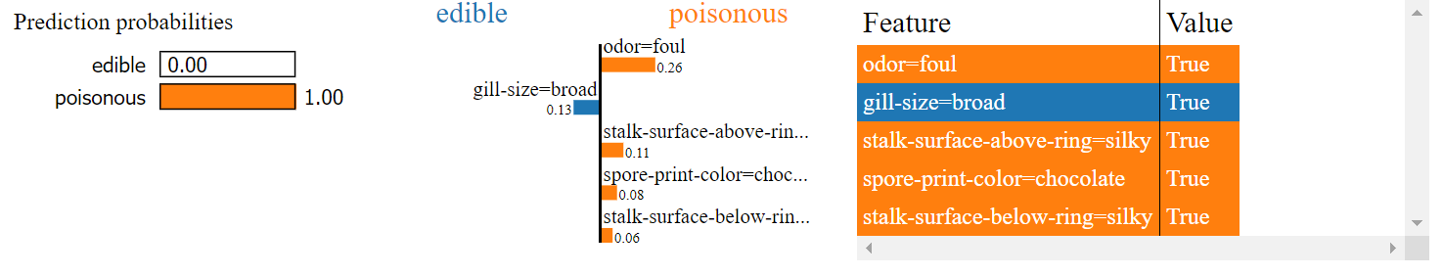
LIME - Tabular Data
Source:
https://marcotcr.github.io/lime/tutorials/Tutorial%20-%20continuous%20and%20categorical%20features.html

Slide 45
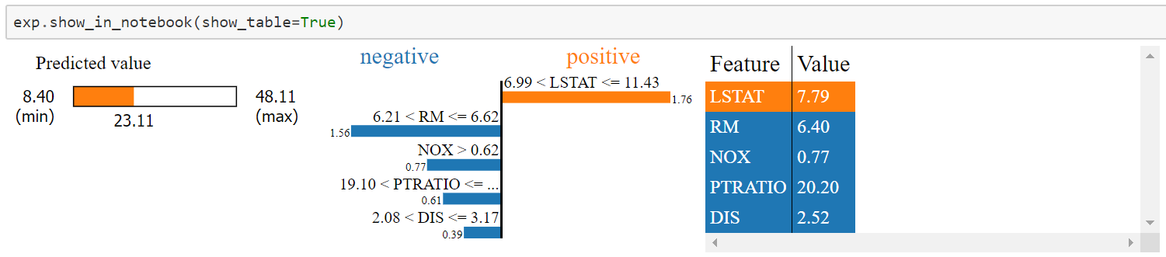
LIME - Tabular Data Regression
Source:
https://marcotcr.github.io/lime/tutorials/Tutorial%20-%20continuous%20and%20categorical%20features.html
Source:​
https://marcotcr.github.io/lime/tutorials/Using%2Blime%2Bfor%2Bregression.html

Slide 46
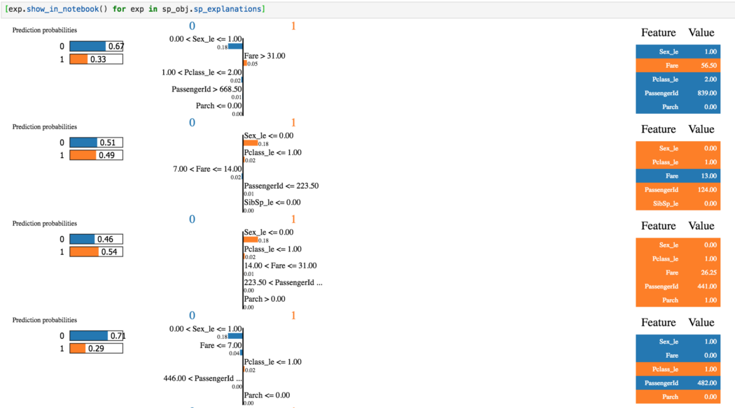
SP-LIME
https://towardsdatascience.com/decrypting-your-machine-learning-model-using-lime-5adc035109b5​

Slide 47
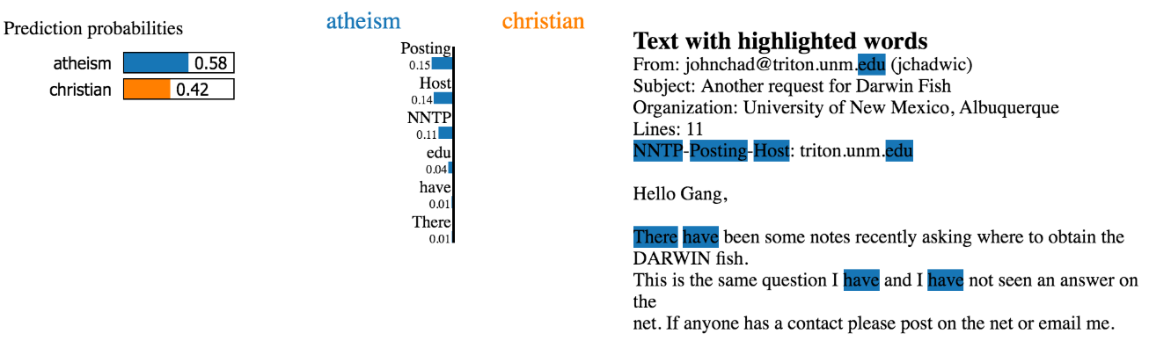
LIME - Text Classification
https://marcotcr.github.io/lime

Slide 48
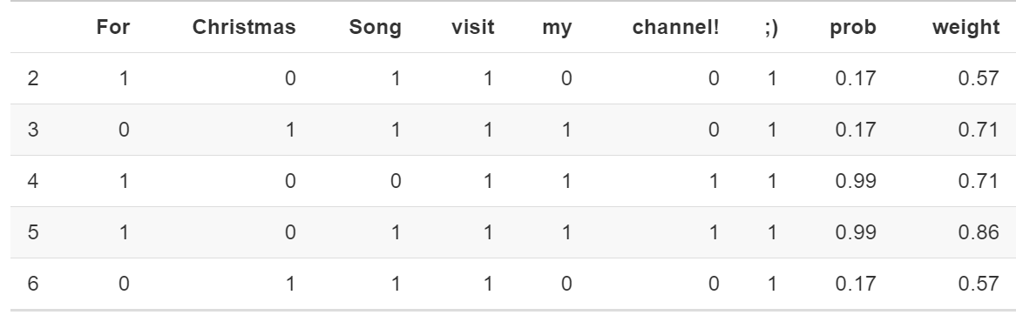
LIME - Text Classification
https://christophm.github.io/interpretable-ml-book/lime.html

Slide 49
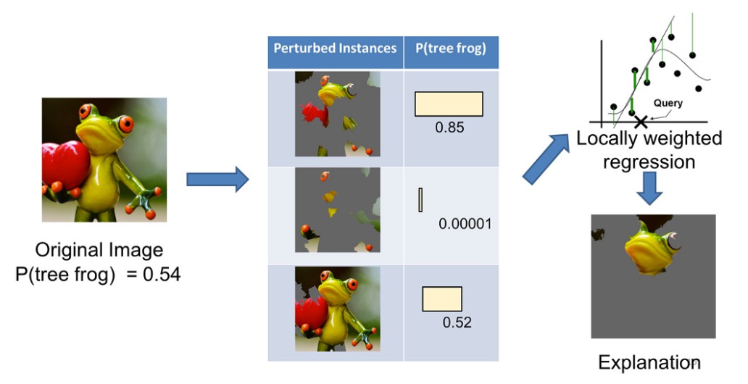
LIME - Images
https://www.oreilly.com/learning/introduction-to-local-interpretable-model-agnostic-explanations-lime

Slide 50
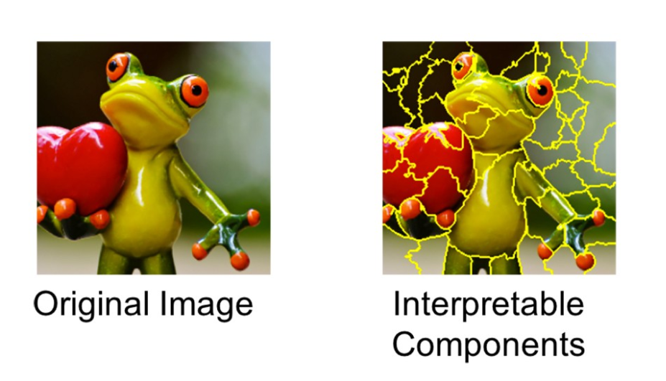
LIME - Images
https://www.oreilly.com/learning/introduction-to-local-interpretable-model-agnostic-explanations-lime

Slide 51
LIME Disadvantages
Neighborhood of sampling - kernel smoothing
Instability
https://christophm.github.io/interpretable-ml-book/lime.html

Slide 52
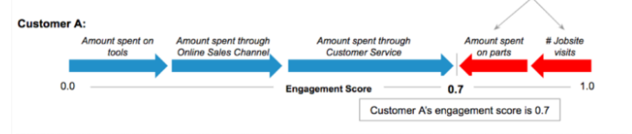
Shapley Additive Explanations (SHAP)
Originates from Game Theory (Shapley Values)
Fair distribution of reward (dividing payoff)
Coalition
Game
Payout
Source:
https://medium.com/civis-analytics/demystifying-black-box-models-with-shap-value-analysis-3e20b536fc80

Slide 53
SHAP
The sum of what everyone receives should equal the total reward
If two people contributed the same value, then they should receive the same amount from the reward
Someone who contributed no value should receive nothing
If the group plays two games, then an individual’s reward from both games should equal their reward from their first game plus their reward from the second game
https://medium.com/@gabrieltseng/interpreting-complex-models-with-shap-values-1c187db6ec83

Slide 54
SHAP
Source:
https://medium.com/civis-analytics/demystifying-black-box-models-with-shap-value-analysis-3e20b536fc80

Slide 55
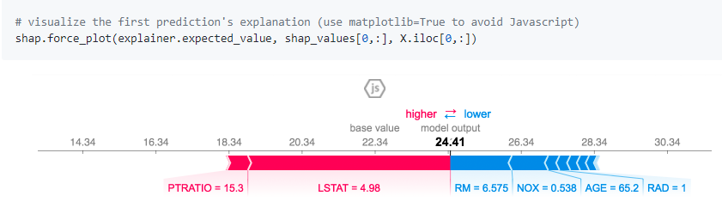
SHAP
Source:
https://github.com/slundberg/shap

Slide 56
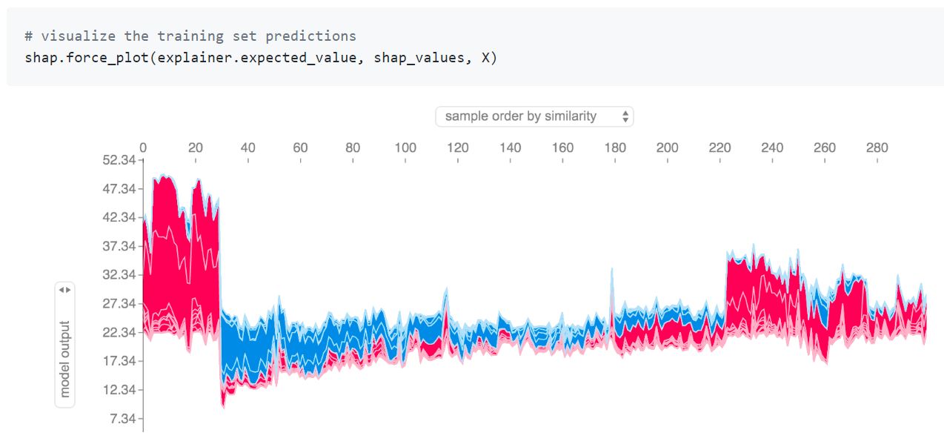
Source:​
https://github.com/slundberg/shap​
https://colab.research.google.com/drive/1738j91J8FANA77riYaRVdqvHahgJ2b3P#scrollTo=xv7DKtQNldVS

Slide 57
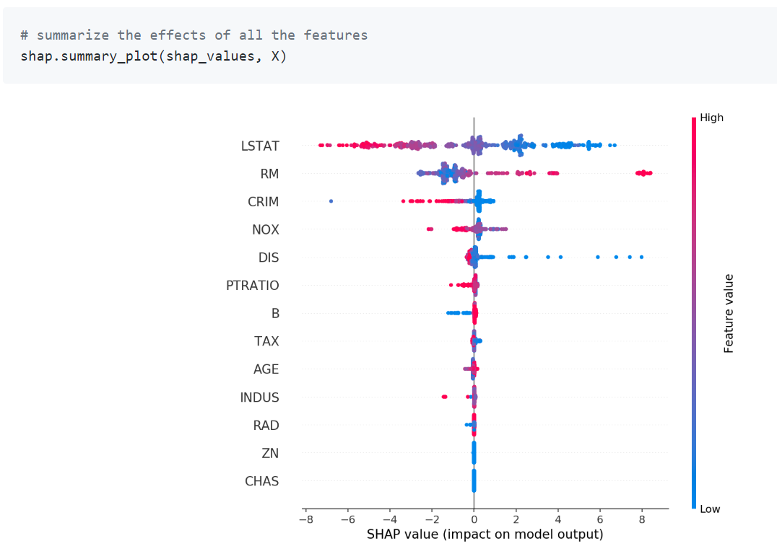
Source:​
https://github.com/slundberg/shap​

Slide 58
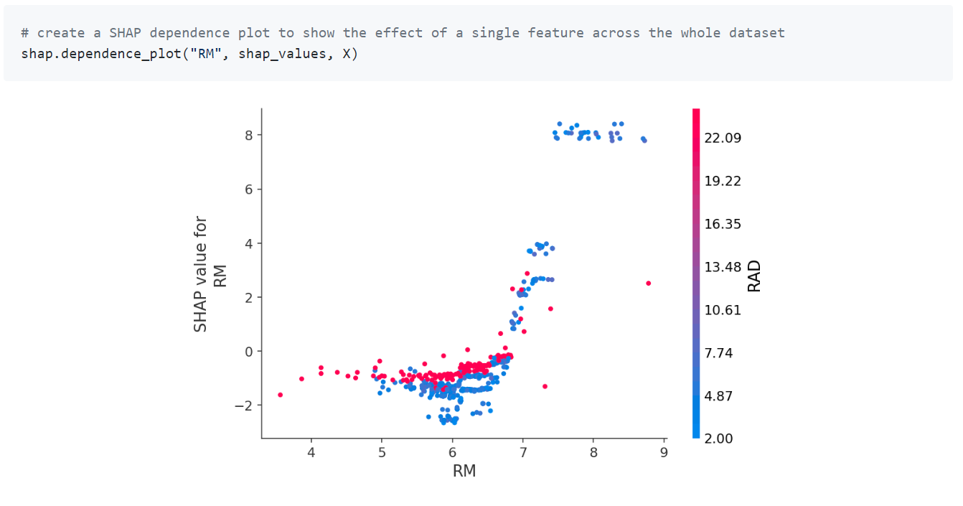
Source:​
https://github.com/slundberg/shap​

Slide 59
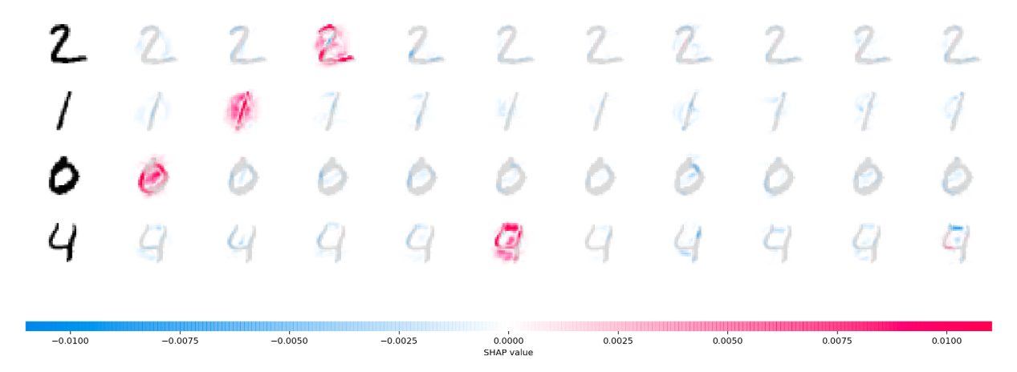
SHAP
Source:​
https://github.com/slundberg/shap​

Slide 60
THANK YOU!
Contact info: kdykho@gmail.com
LinkedIn: https://www.linkedin.com/in/kvnkho/

